Slide 1
CHAPTER-ONE
INTRODUCTION TO PROGRAMMING

Slide 2
1.1 Introduction
A Computer
is an electronic device that accepts data, performs computations, and makes logical decisions according to instructions/computer program/ that have been given to it and produces meaningful information in a form that is useful to the user.
The terms computer programs, software programs, or just programs are the instructions that tells the computer what to do
Computer programming is the process of writing, testing, debugging/ troubleshooting, and maintaining the source code of computer programs

Slide 3
Con…
A computer program usually consists of two elements:
Data – characteristics
Code – action
Computer Programmers: is often written by professionals
A programming language: is an artificial language that can be used to control the behavior of a machine
Programming languages, like natural language (such as Amharic), are defined by syntactic and semantic rules which describe their structure and meaning respectively.
The syntax of a language describes the possible combinations of symbols that form a syntactically correct program.
The meaning given to a combination of symbols is handled by semantics
in general the main purpose of programming languages is to provide instructions to a computer.

Slide 4
Generations of programming language
First Generation Languages :
These are low-level languages like machine language.
Second Generation Languages :
These are low-level assembly languages used in kernels and hardware drives.
Third Generation Languages :
These are high-level languages like C, C++, Java, Visual Basic and JavaScript.
Fourth Generation Languages :
consist of statements that are similar to statements in the human language.
used mainly in database programming and scripting.
Example of these languages include Perl, Python, Ruby, SQL, MatLab(MatrixLaboratory).
Fifth Generation Languages :
have visual tools to develop a program.
Examples of fifth generation language include Mercury, OPS5, and Prolog.

Slide 5
Types of programming paradigm
The imperative programming paradigm:
was one of the earliest and was developed using machine-language.
It is also the basis on which all hardware is implemented
weaknesses are order sensitive and the limitation of abstraction.
Functional programming:
is essentially less complex and offers better readability than imperative.
have been originated from a mathematical discipline
Logical paradigm:
is massively different that it focuses primarily on establish logic—relation
Object-Oriented paradigm: focuses on objects, it represent and the behavior they exhibit

Slide 6
Levels of Programming Languages
Low-level languages
machine languages:
Computers only understand one language and that is binary language or the language of 1s and 0s.
Machine language programs are executable, meaning that they can be run directly.
Programming in machine language requires memorization of the binary codes and can be difficult for the human programmer.
Assembly language:
correspondences symbolic instructions and executable machine codes
created to use letters to each machine language instructions to make it easier to remember or write.
The machine language instructions are replaced with simple pneumonic abbreviations (e.g., ADD, MOV)
For example: ADD A, B – adds two numbers in memory location A and B
The assembly language must be translated to machine code by a separate program called assembler

Slide 7
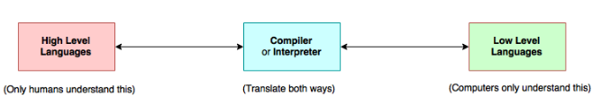
High-level languages
High-level languages, like C,C++, JAVA etc., are more English-like and, therefore, make it easier for programmers to “think” in the programming language
High-level languages also require translation to machine language before execution (source code to object code).
This translation is accomplished by either a compiler or an interpreter.
Compilers translate the entire source code program before execution.
Interpreters translate source code programs one line at a time
Types of high-level language
Procedural Programming Languages
Structured Programming Languages
Object-Oriented Programming Languages

Slide 8
Problem solving Techniques
A program is not needed only to solve a problem but also it should be reliable, (maintainable) portable and efficient.
In computer programming three facts are given more weight.
Defining the problem
logical procedures to follow in solving it.
Introduces the means by which programmers communicate those procedures to the computer system so that it can be executed.
define the problem: use system analysis and design tools, particularly flowchart and structure chart to get to solution.
Algorithm: the procedure, or solution, selected
An algorithm is defined as a step-by-step sequence of instructions that must terminate and describe how the data is to be processed to produce the desired outputs.
commonly used tools to document the algorithm
flowcharts,
structured chart, and
Pseudo code

Slide 9
Pseudo code
is a compressed and informal high-level description of a computer algorithm that uses the structural conventions of programming languages.
May ignores details such as
subroutines,
variables declarations and
system-specific syntax
No standard for pseudocode syntax exists, as a program in pseudocode is not an executable program.
E.g. Write a program that obtains two integer numbers from the user. And that will print out the sum of those numbers.
Pseudocode:
Prompt the user to enter the first integer
Prompt the user to enter a second integer
Compute the sum of the two user inputs
Display an output prompt that explains the answer as the sum
Display the result

Slide 10
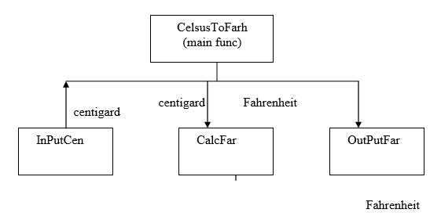
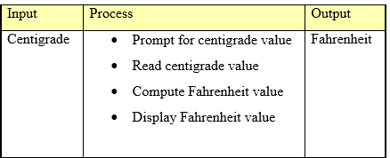
Structured Charts
Structured chart depicts the logical functions to the solution of the problem using a chart
Example: Write a program that asks the user to enter a temperature reading in centigrade and then prints the equivalent Fahrenheit value.
Pseudo code
The lines represent the connection and or ownership between activities and sub-activities

Slide 11
Class activity one
Write pseudo code that reads two numbers and multiplies them together and print out their product.
Write pseudo code that tells a user that the number they entered is not a 5 or a 6.
Write pseudo code that will perform Reading of 5 separate numbers and calculate the average of these five numbers.
Write pseudo code to print all multiples of 5 between 1 and 100 (including both 1 and 100).
Write pseudo code that will count all the even numbers up to a user defined stopping point.
Solution

Slide 12
Flowchart
A flowchart
is a schematic representation of an algorithm or a process.
The advantage of flowchart is it doesn’t depend on any particular programming language, so that it can used, to translate an algorithm to more than one programming language.
Flowchart uses different symbols (geometrical shapes) to represent different processes.
The following table shows some of the common symbols

Slide 13
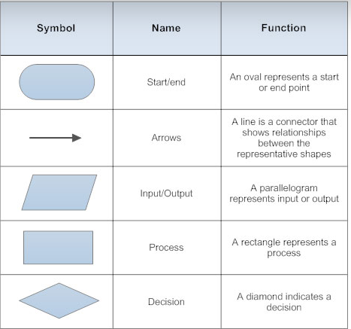
Con…

Slide 14
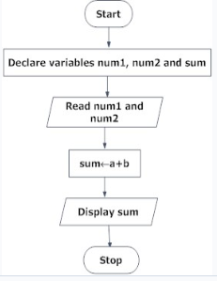
Examples of flowcharts in programming
Draw a flowchart to add two numbers entered by user.

Slide 15
Class activity two
Draw flowchart to find the largest among three different numbers entered by user.
Write an algorithm description and draw a flow chart to check a number is negative or not.
Algorithm

Slide 16
System Development Life Cycle (SDLC)
is a conceptual model used in project management that describes the stages involved in a computer system development project from an initial feasibility study through maintenance of the completed application.
The phases of SDLC are discussed below briefly.
Feasibility study
Organizational Feasibility
Economic Feasibility
Technical Feasibility
Hardware, software, and network capability, reliability, and availability
Operational Feasibility
End user acceptance
Requirements analysis
Designing solution
Testing designed solution
Implementation
Unit testing
Integration and System testing
Maintenance

Slide 17

Everyday in your life you should learn how to program a computer Because it teaches you how to think.
Steve Jobs [Founder of Apple computer]
Software is like humanity because it is all about helping peoples by using computer technology
Vanessa [girl develop IT}

